Slide 1






FINANCE POLICY AND GOVERNMENT ORDER KNOWLEDGE INTELLIGENCE PLATFORM — FINANCE DEPARTMENT, GOVERNMENT OF KERALA
Secure, Air-Gapped AI for Government Financial Policy

Slide 2








INTRODUCTION
Kerala Finance KIP is an AI-powered platform designed to make government document management easier and more efficient. It helps officials quickly find, understand, and verify important financial documents through smart search, document tracking, automated extraction, and AI assistance. The entire system runs locally, ensuring that sensitive financial information remains secure and protected.

Slide 3


CORE PROBLEM
Information Overload:
Government finance departments handle thousands of complex orders, budgets, and GST circulars.
The Risks of Manual Work:
Manual retrieval and drafting lead to critical errors, massive delays, and the accidental citation of outdated or superseded policies.
The Security Roadblock:
Relying on public cloud AI to
solve this is impossible due to strict data privacy and Zero-Trust government laws.

Slide 4

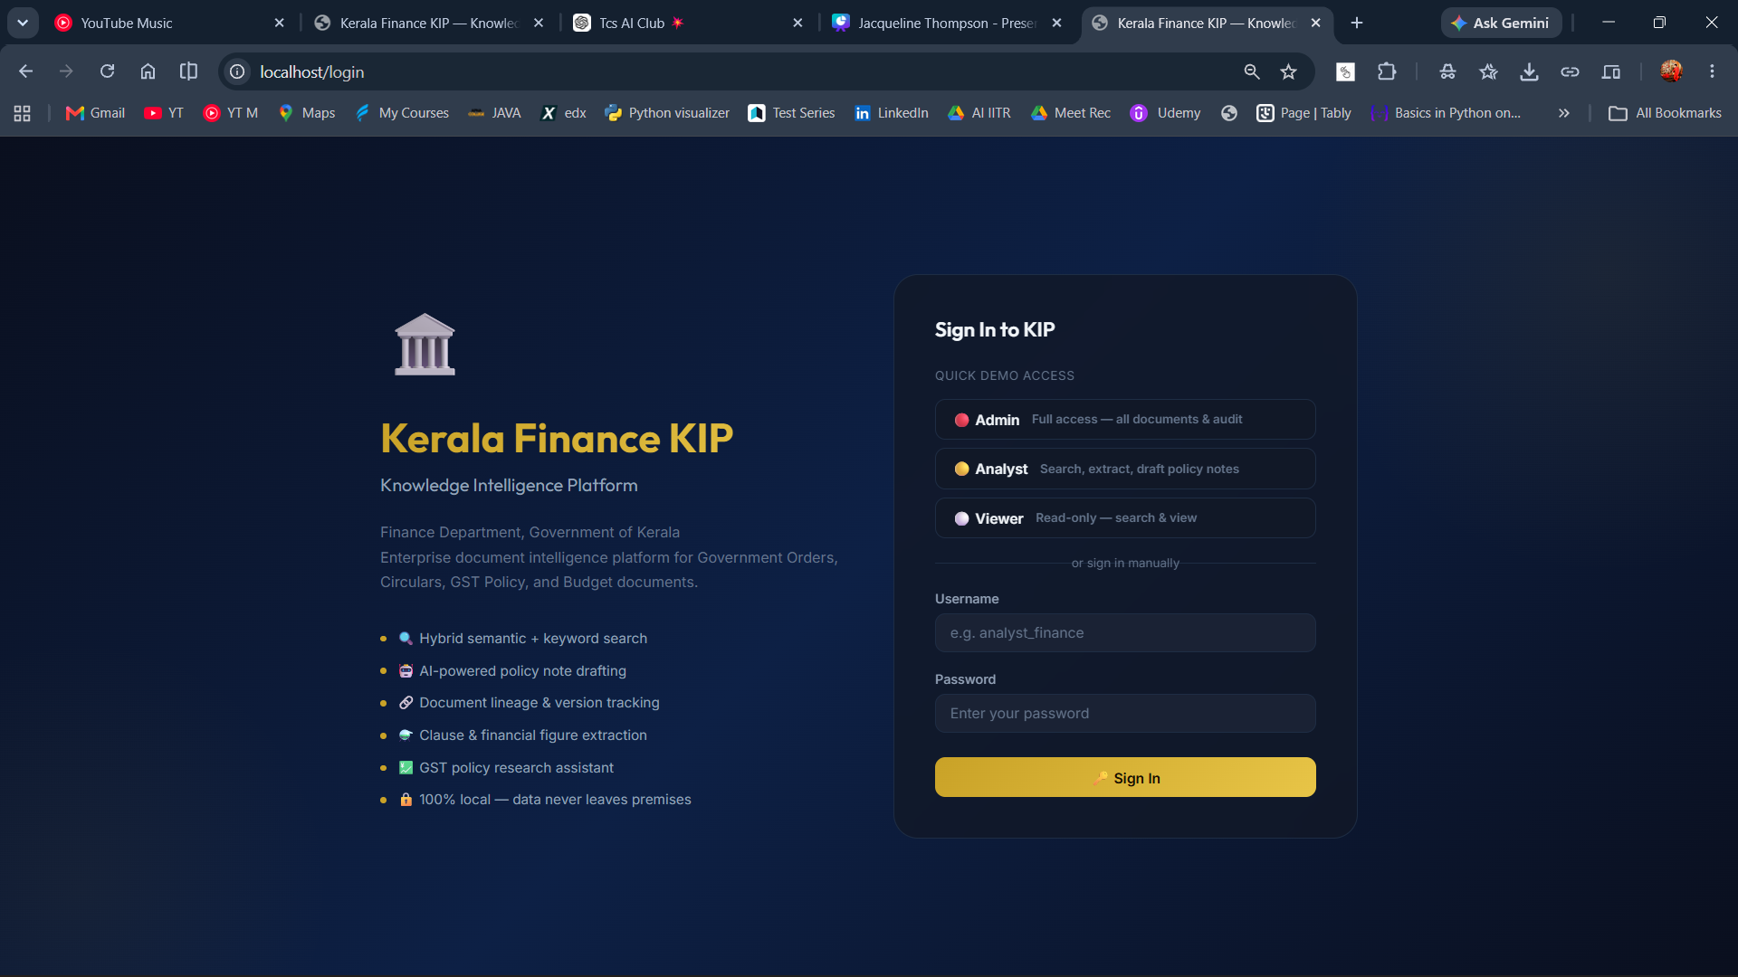
OUR SOLUTION
01
The KIP Platform:
A completely offline, air-gapped Enterprise AI Knowledge Platform.
How It Works:
We ingest raw PDFs, perform local OCR, and use secure vector embeddings to make every financial document instantly searchable.
02
03
Total Security:
All generative AI drafting, natural language search, and data processing happens 100% locally. The data never leaves the premises.

Slide 5
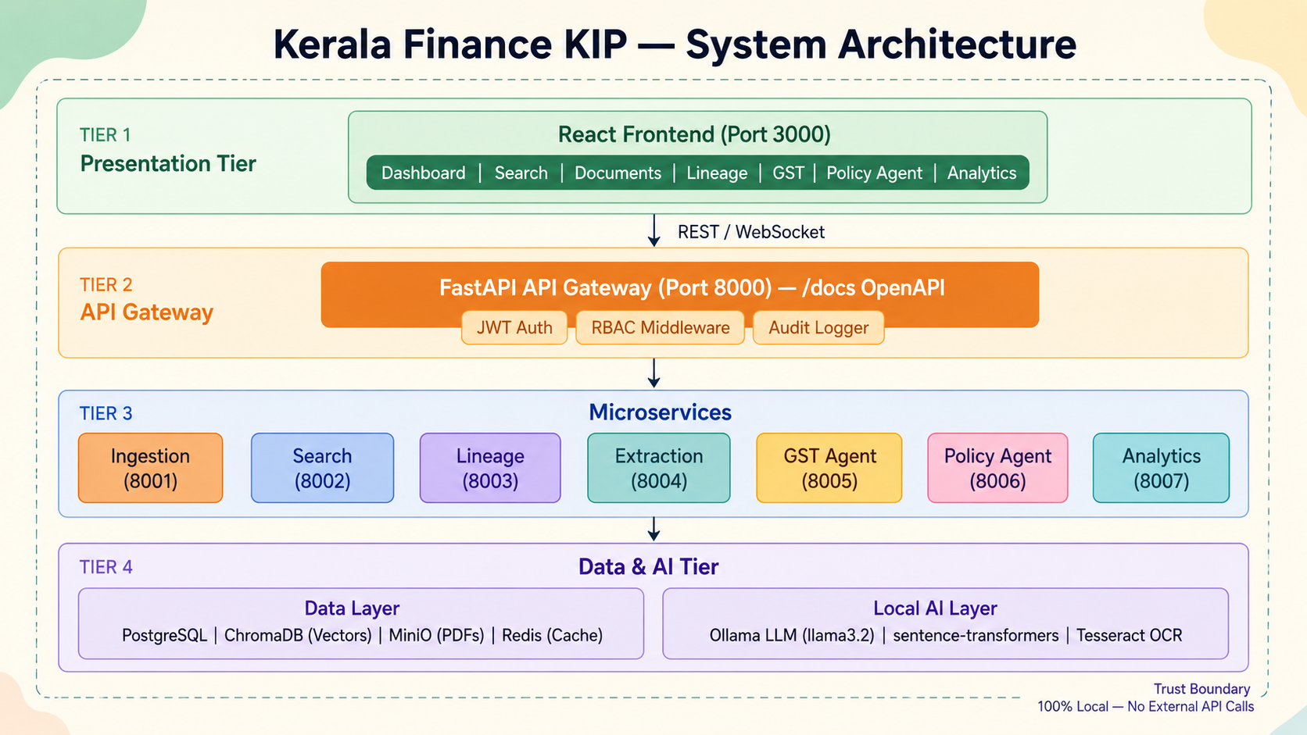

Slide 6
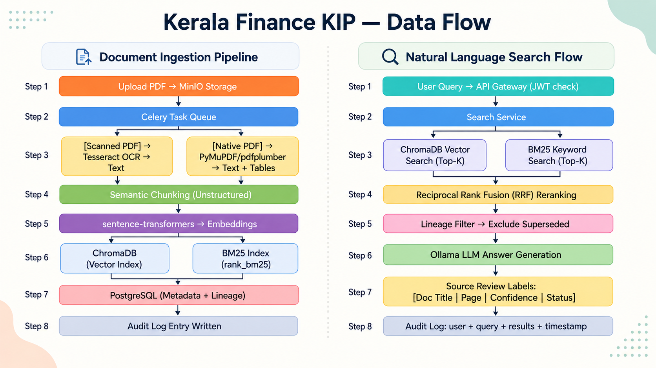

Slide 7
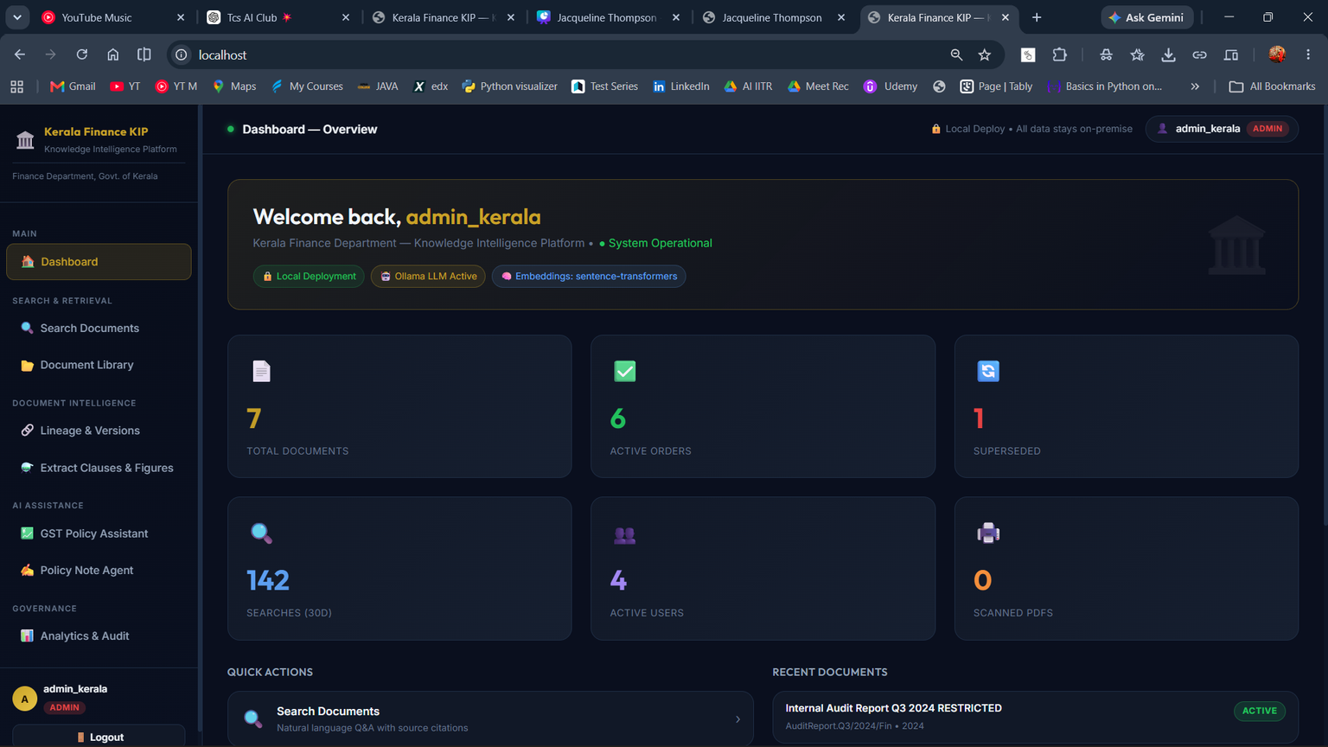
Thank You, Jury
THE JOURNEY FROM ROUND 1
We deeply appreciated the Round 1 feedback. It challenged us to elevate our prototype into an enterprise-grade solution.
The 8-Point Challenge
You provided us with 8 specific "Missing Features & Areas for Enhancement."
Our Goal
Instead of just patching a few features, we completely re-architected our platform to deliver all 8 of your requests. Today, we will show you exactly how.

Slide 8
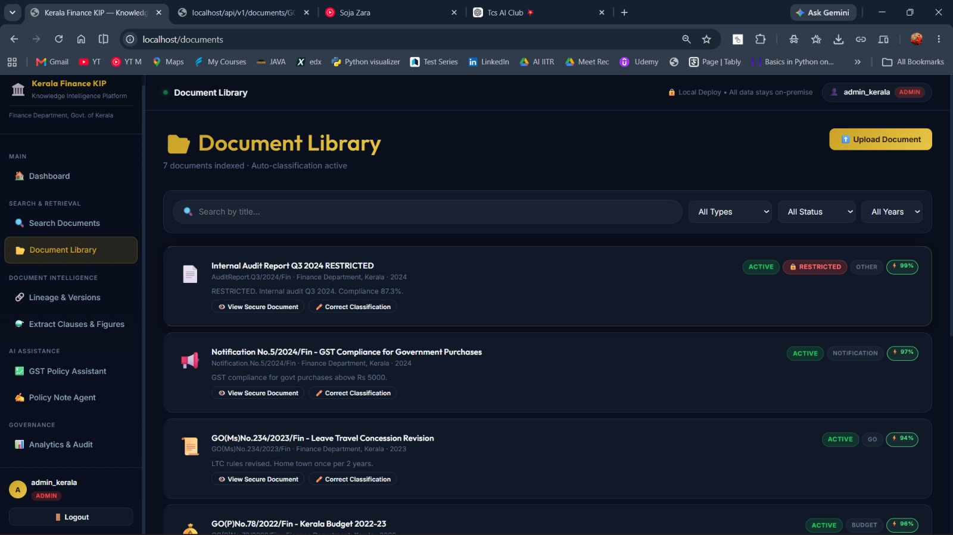
INTELLIGENT DOCUMENT PROCESSING
Automated Classification:
Every uploaded document passes through an AI pipeline that automatically extracts the Authority, Year, Subject, and Document Type.
01
Confidence Scoring:
The AI assigns a Confidence Score (e.g., 97%) to its classification, ensuring complete auditability.
02
Advanced Filtering:
We built a dedicated Document Library where officials can instantly filter thousands of GOs by Year, Status, or Authority.
03

Slide 9
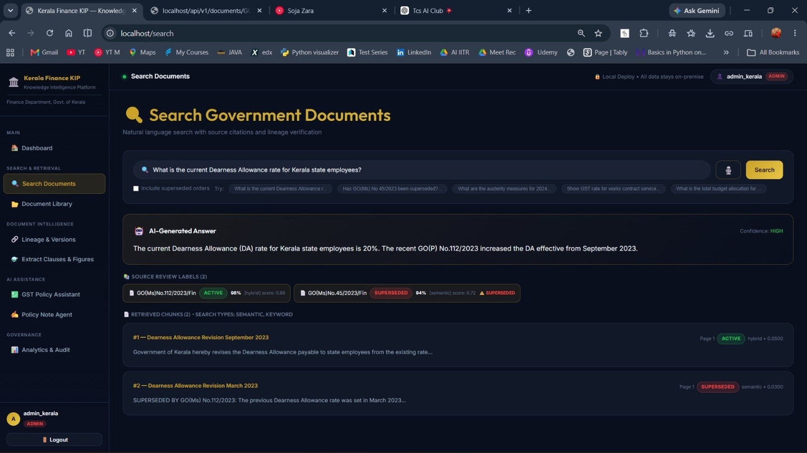

THE "SUPERSEDED ORDER" TRAP
The Danger:
Citing an outdated GO(Government Order) in a new policy note can cause massive financial discrepancies.
01
02
Our Solution:
We built a dynamic lineage graph.
How it Works:
If an official searches for a policy, the AI actively intercepts superseded orders and applies a massive SUPERSEDED warning, forcing the AI to only cite active, current orders.
03

Slide 10
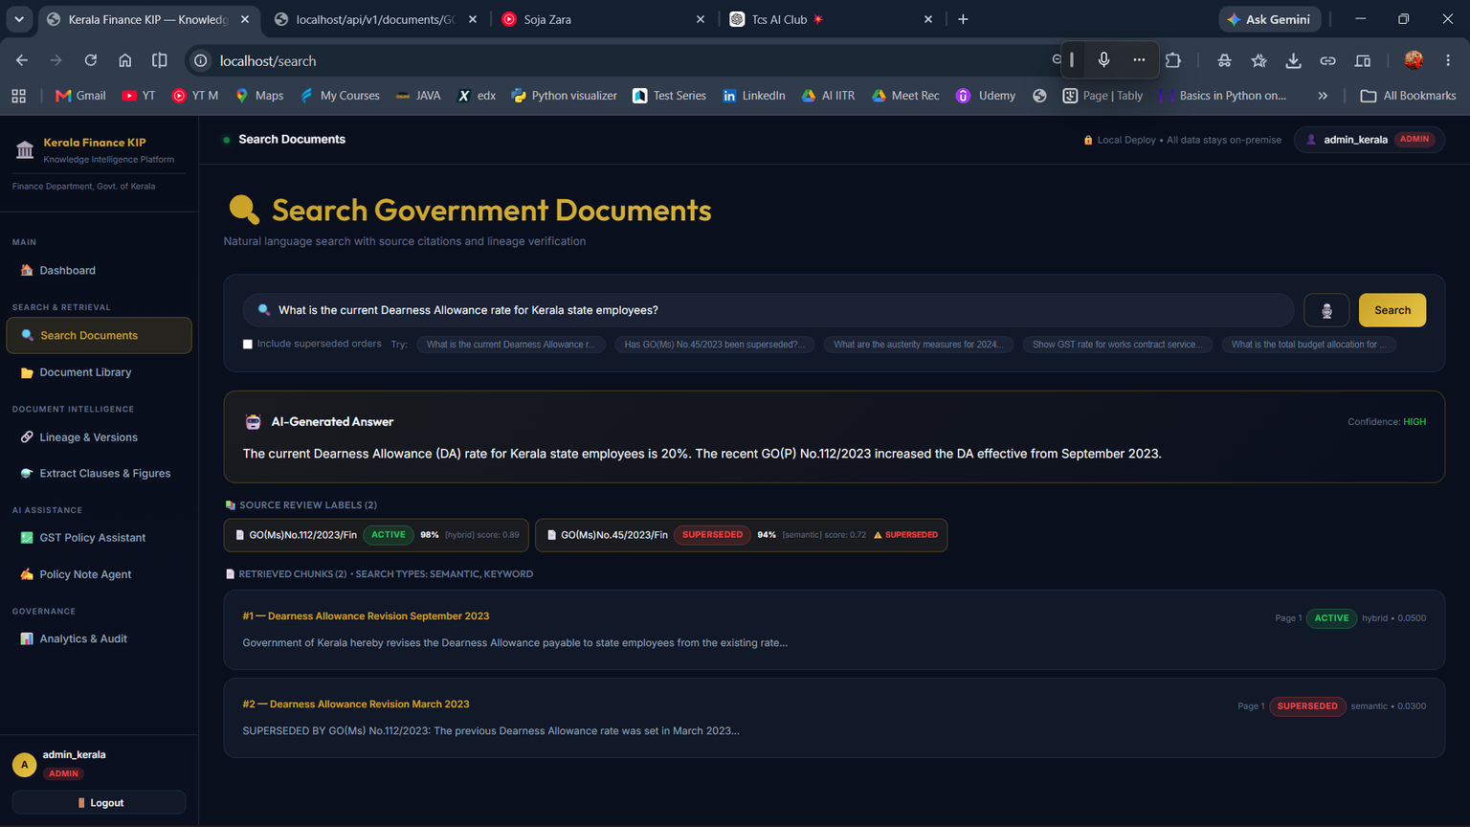
OFFLINE AUDIO INTERACTION
The Requirement:
Voice interaction for ease of use.
01
The Constraint:
Government financial data cannot be sent to cloud APIs like Google or OpenAI for speech-to-text.
02
Our Solution:
We integrated a 100% local, offline Speech-to-Text adapter. Officials can dictate queries securely without any data ever leaving the local server.
03

Slide 11
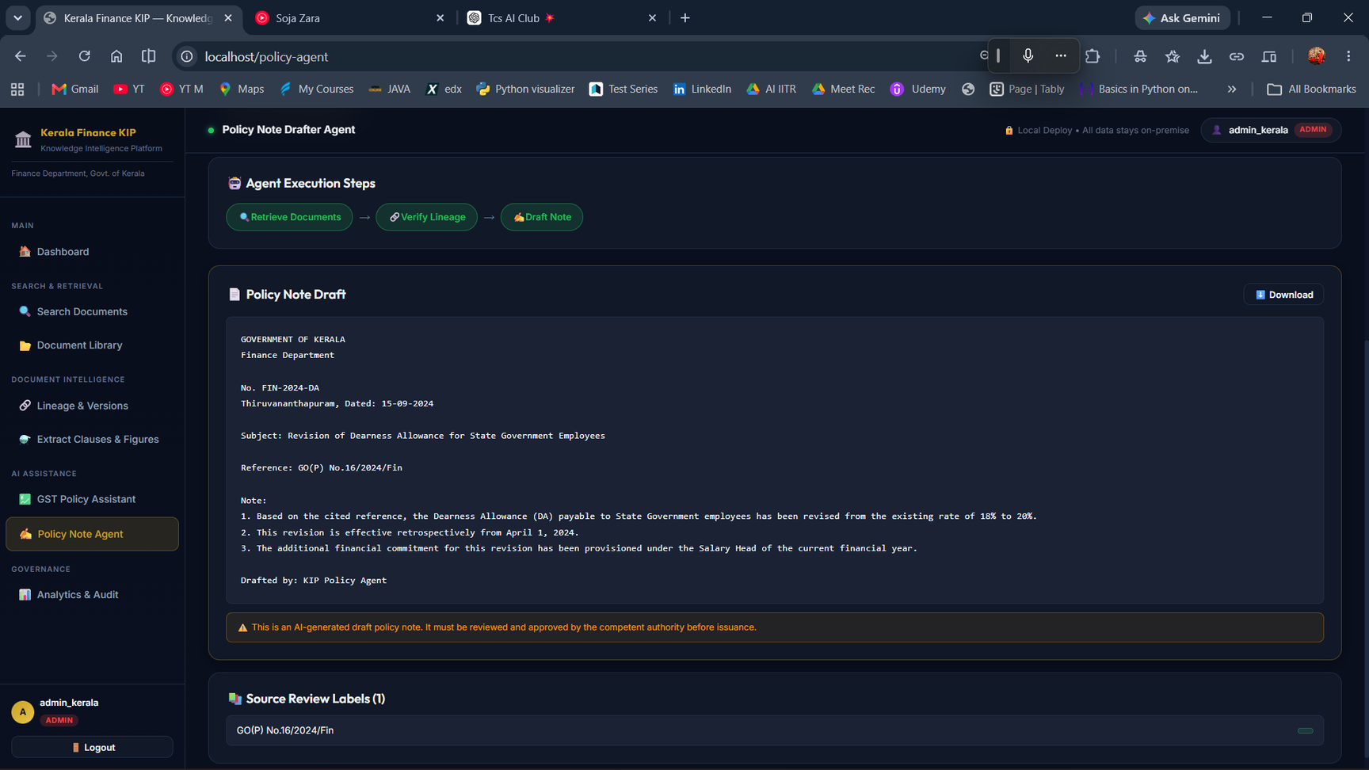
TRACEABLE POLICY-NOTE DRAFTING
Beyond Chatbots:
An official doesn't just need a chat answer; they need an official Secretariat draft.
The Agent Workflow:
Retrieves active GOs.
Extracts financial figures.
Formats the data directly into the official Kerala Secretariat manual template.
The Result:
Hours of manual drafting reduced to a 5-second, fully traceable process.

Slide 12
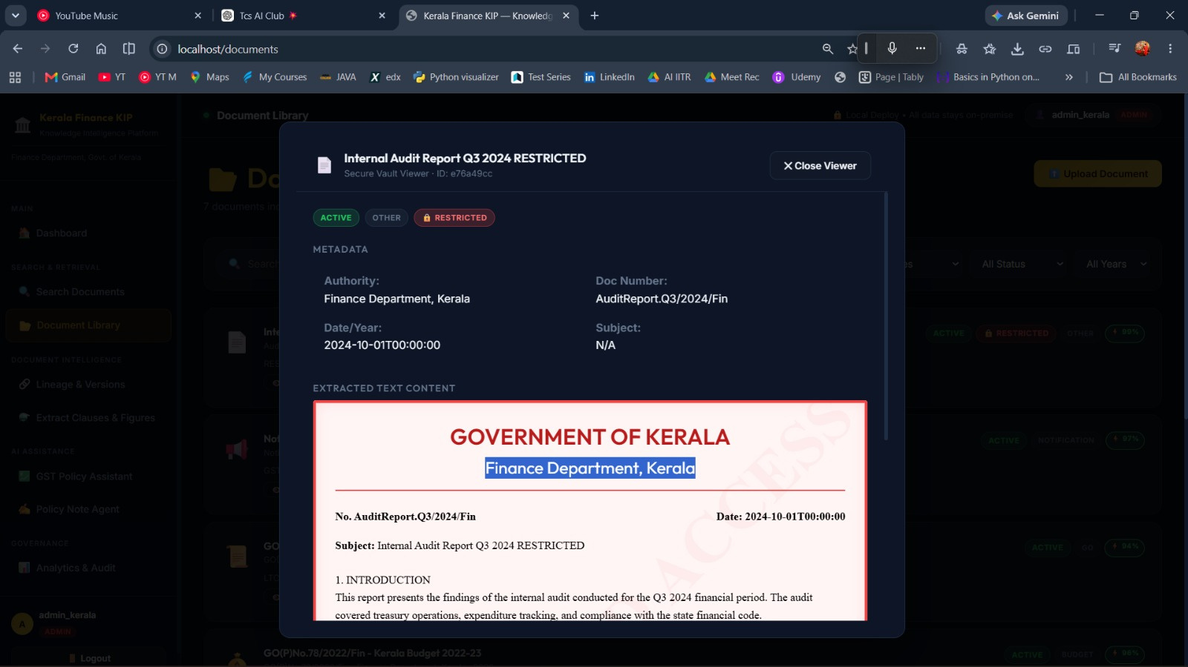
ZERO-TRUST SECURITY & PERSONALIZATION
Role-Based Access Control:
Not all documents are public. Some are highly sensitive internal audits.
01
Granular Permissions:
We implemented strict RBAC. If a standard analyst searches the database, restricted documents are entirely hidden from their AI context window.
02
Secure Viewer:
Raw PDFs cannot be downloaded; they are viewed through a secure, tracked internal vault viewer.
03

Slide 13
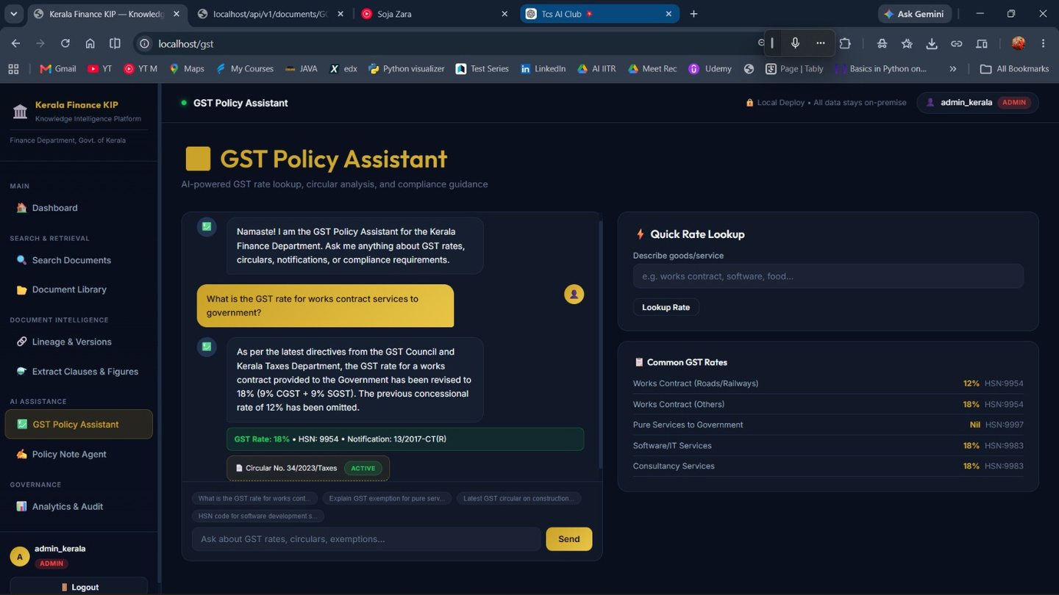
GST POLICY ASSISTANT
Specialized Intelligence:
We deployed a dedicated AI agent solely for navigating complex tax queries.
01
Direct Citations:
When an official asks for the GST rate on government works contracts, the AI doesn't just say "18%".
02
Verifiability:
It provides the exact HSN code and a clickable citation directly to Circular 34/2023, allowing instant human verification.
03

Slide 14
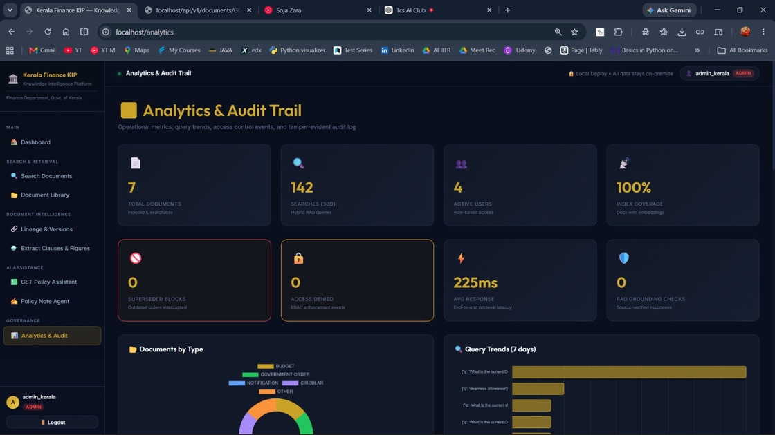
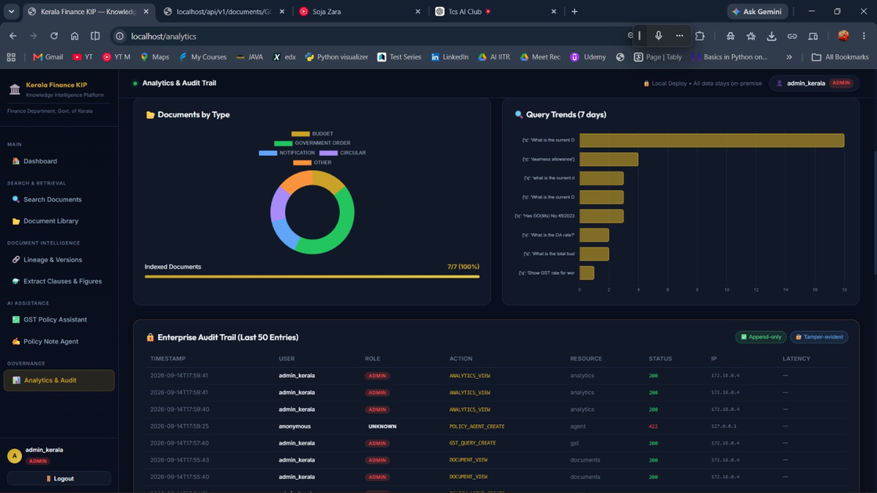
OPERATIONAL ANALYTICS & AUDIT DRILL-DOWNS
Transparency
Real-Time Metrics
We built a comprehensive Admin Dashboard.
Track total documents, active vs. superseded orders, and daily query volume.
Tamper-Proof Audit Log
Every search query, document view, and permission denial is permanently logged with the User ID and timestamp, ensuring full government compliance

Slide 15




CONCLUSION
From Documents to Trusted Decisions
A secure Knowledge Intelligence Platform for the Kerala Finance Department that transforms scattered finance policies and Government Orders into searchable, traceable, and actionable knowledge.
  Find the right information faster
  Verify it against authoritative and current sources
  Draft policy notes with traceable evidence
  Govern access, usage, and decisions through auditability
Enabling faster, safer, and more accountable financial decision-making.

Slide 16




Thank
You

